Slide 1
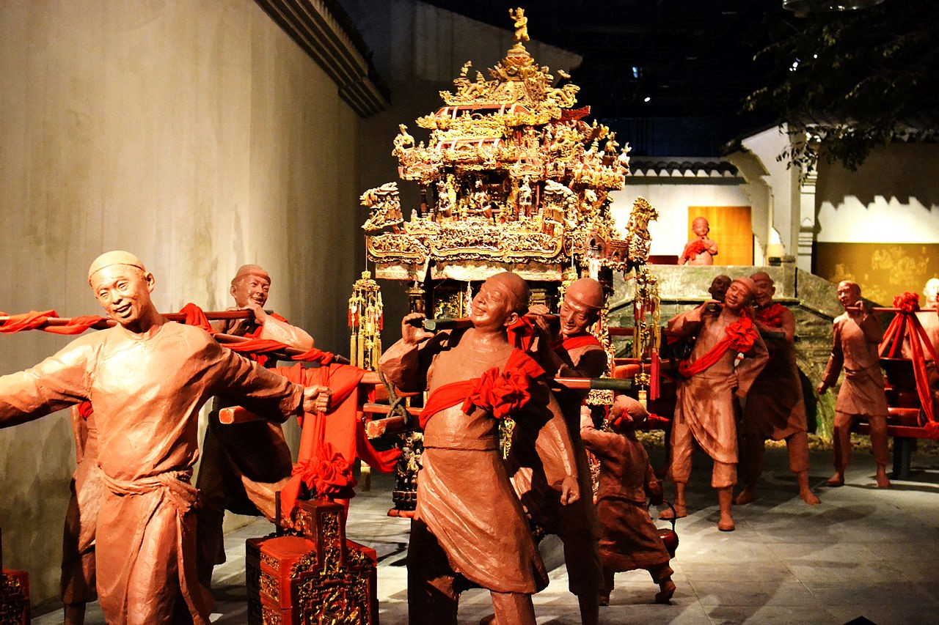
LIS562: Descriptive Metadata

Slide 2
UC Libraries Bib Services Task Force Final Report (12/2005)
The task force agrees that our bibliographic systems should accommodate multiple metadata schemes. We also agree that controlled vocabularies are still very valuable for name, uniform title, date, and place. Not all agree, though, that the current controlled vocabularies are as effective for topical subjects. The different points of view which arose during our discussions included:
As we import or link to more full text and enhanced descriptive metadata, apply sophisticated algorithms to that metadata, and provide richer retrieval and browsing options, using controlled vocabularies such as LCSH and MeSH for topical subjects is no longer as necessary or valuable. Given our limited cataloging resources, we should apply subject analysis only to material that is not self-discoverable through textual searching. Where controlled vocabulary is used, we should replace the traditional LCSH structure with a more structured syntax such as FAST, which is more machine-actionable.

Slide 3
UC Libraries Bib Services Task Force Final Report (12/2005)
“III.2a: RECOMMENDATION: Use level of description and schema (DC, LOM, VRA Core, etc,) appropriate to the bibliographic resource. Don’t apply MARC, AACR2, and LCSH to everything.
III.2b: RECOMMENDATION: Consider the value of implementing the FAST syntax with special attention to ‘place’ and ‘time periods’ in order to support faceted browsing in those categories.
III.2c: RECOMMENDATION: Consider using controlled vocabularies only for name, uniform title, date, and place, and abandoning the use of controlled vocabularies [LCSH, MESH, etc] for topical subjects in bibliographic records. Consider whether automated enriched metadata such as TOC, indexes can become surrogates for subject headings and classification for retrieval.
III.2d: RECOMMENDATION: In allocating resources to descriptive and subject metadata creation, consider giving preference to those items that are completely undiscoverable without it, such as images, music, numeric databases, etc. Consider whether automated metadata creation techniques can be used for all textual materials.”

Slide 4
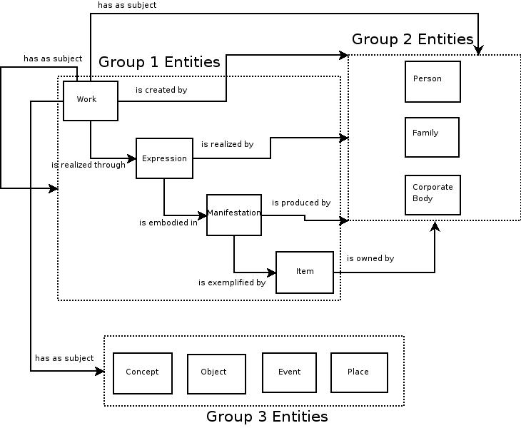
FRBR Entities

Slide 5
MARC Record
Title: A companion to digital humanities / edited by Susan Schreibman, Ray Siemens, and John Unsworth.
Series: Blackwell companions to literature and culture ; 26
Published: Malden, MA : Blackwell Pub., c2004.
Physical Description: xxvii, 611 p. : ill. ; 26 cm.
Includes: Includes bibliographical references and index.
Related URL: Table of contents http://www.loc.gov/catdir/toc/ecip0415/2004004337.html
Subject (LCSH): Humanities -- Data processing. Humanities -- Research -- Data processing. Information storage and retrieval systems -- Humanities.
Other Name: Schreibman, Susan. Siemens, Raymond George, 1966- Unsworth, John (John M.)
ISBN: 1405103213 (hardcover : alk. paper)
LC Card Number: 2004004337
Other Identifying Number: V5-K55931
Institution: University of Illinois at Urbana-Champaign
Library Location: Main Stacks Call Number: 001.30285
Copy: 1
Status: c.1 Checked out - Due on 05-06-10

Slide 6
EAD in the FRBR World
<filedesc> File Description: A required subelement of the <eadheader> that bundles much of the bibliographic information about the finding aid, including its author, title, subtitle, and sponsor (all in the <titlestmt>), as well as the edition, publisher, publishing series, and related notes (encoded separately).
<profiledesc> Profile Description: An optional subelement of the <eadheader> that bundles information about the creation of the encoded version of the finding aid, including the name of the agent, place, and date of encoding. The <profiledesc> element also designates the predominant and minor languages used in the finding aid. Do not confuse with <filedesc>, which bundles such bibliographic information as the title, author, publisher, edition, and publishing series of the finding aid.
<dao> Digital Archival Object: A linking element that uses the attributes ENTITYREF or HREF to connect the finding aid information to electronic representations of the described materials. The <dao> and <daogrp> elements allow the content of an archival collection or record group to be incorporated in the finding aid. These digital representations include graphic images, audio or video clips, images of text pages, and electronic transcriptions of text. The objects can be selected examples, or digital surrogates all the materials in an archival fonds or series.

Slide 7
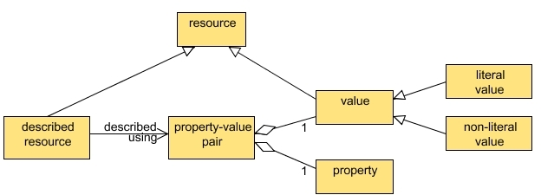
Dublin Core Abstract Model
3. Descriptions, description sets and records
The abstract model presented above indicates that each DC metadata description describes one, and only one, resource. This is commonly referred to as the one-to-one principle. However, real-world metadata applications tend to be based on loosely grouped sets of descriptions (where the described resources are typically related in some way), known here as description sets.
DCMI Abstract Model, http://dublincore.org/documents/abstract-model/
Notes:
The abstract model of the resources described by descriptions is as follows:
* Each described resource is described using one or more property-value pairs.
* Each property-value pair is made up of one property and one value.
* Each value is a resource - the physical, digital or conceptual entity or literal that is associated with a property when a property-value pair is used to describe a resource. Therefore, each value is either a literal value or a non-literal value:
* A literal value is a value which is a literal.
* A non-literal value is a value which is a physical, digital or conceptual entity.
* A literal is an entity which uses a Unicode string as a lexical form, together with an optional language tag or datatype, to denote a resource (i.e. "literal" as defined by RDF [RDF]).

Slide 8
Ecological Metadata Language
Top-level Resources
The eml-dataset module: Dataset specific information
The eml-literature module: Citation specific information
The eml-software module: Software specific information
The eml-protocol module: Research protocol specific information

Slide 9
Categories for the Description of Works of Art
FOR THE OBJECT, ARCHITECTURE, OR GROUP
Catalog Level Object/Work Type Classification Term Title or Name Measurements Description Materials and Techniques Description Creator Description Creator Identity Creator Role Creation Date Earliest Date Latest Date Subject Matter Indexing Terms Current Location Repository Name/Geographic Location Current Repository Numbers
FOR CREATOR IDENTIFICATION AUTHORITY Name Source Display Biography Birth Date Death Date Nationality/Culture/Race Life Roles
FOR PLACE/LOCATION AUTHORITY Place Name Source Place Type Broader Context
FOR GENERIC CONCEPT AUTHORITY Term Source Broader Context Scope Note Source

Slide 10
Categories for the Description of Works of Art
RELATED VISUAL DOCUMENTATION [references to Object/Work] Image References Image to Work Relationship Type
Image Label/Identification Image Catalog Level Image Type Image Title/Name Image Title Type Image Measurements
Dimensions Type Dimensions Value Dimensions Unit Image Format Image Date Earliest Date Latest Date
Image Color Works Depicted Image View Description View Type View Subject View Subject Indexing Terms View Date Earliest Date Latest Date Image Maker/Agent Image Maker Role Image Maker Extent Image Repository Image Repository Numbers Number Type etc. etc.

Slide 11
MODS Elements
• titleInfo
• name
• typeOfResource
• genre
• originInfo
• language
• physicalDescription
• abstract
• tableOfContnts
targetAudience
• note
• subject
• classification
• relatedItem
• titleInfo
• name
• typeOfResource
• genre
• originInfo
• language
• physicalDescription
• abstract
• tableOfContnts
• targetAudience
• note
• subject
• classification
• relatedItem
• identifier
• location
• accessCondition
• part
• extension
• recordInfo
• identifier
• location
• accessCondition
• part
• extension
• recordInfo

Slide 12
FRBR via MODS
Author: Scott, Walter, Sir, 1771 / Work: Heart of Midlothian
* Form: text - English
o Edition:
+ Title: The heart of Midlothian
+ Statement of responsibility: Sir Walter Scott ; edited with an introduction and notes by Claire Lamont.
+ Imprint: Oxford University Press, 1999
+ Physical Description: xxviii, 583 p. : ill. ; 20 cm.
+ ISBN: 019283567X
o Edition:
+ Title: The heart of Mid-Lothian
+ Statement of responsibility: Sir Walter Scott ; edited with an introduction and notes by Tony Inglis.
+ Imprint: Penguin Books, 1994
+ Physical Description: lvi, 793 p. ; 20 cm.
+ ISBN: 0140431292
o Edition:
+ Title: The heart of Mid-Lothian
+ Statement of responsibility: Sir Walter Scott ; preface &glossary by W.M. Parker.
+ Imprint: J.M. Dent, 1988
+ Physical Description: xvi, 560 p. ; 20 cm.
+ ISBN: 0460870904

Slide 13
Meta-Metadata: MODS
20. recordInfo
Subelements:
recordContentSource
recordCreationDate
recordChangeDate
recordIdentifier
recordOrigin
recordInfoNote
languageOf Cataloging
Subelements:
languageTerm
scriptTerm
descriptionStandard

Slide 14
Dublin Core: Simple
“The Dublin Core Metadata Element Set is a vocabulary of fifteen properties for use in resource description.”
“The fifteen element "Dublin Core" described in this standard is part of a larger set of metadata vocabularies and technical specifications maintained by the Dublin Core Metadata Initiative (DCMI). The full set of vocabularies, DCMI Metadata Terms [DCMI-TERMS], also includes sets of resource classes (including the DCMI Type Vocabulary [DCMI-TYPE]), vocabulary encoding schemes, and syntax encoding schemes.”
The Dublin Core Metadata Element Set has been standardized in the following documents:
ISO Standard 15836-2003 of February 2003 [ISO15836]
ANSI/NISO Standard Z39.85-2007 of May 2007 [NISOZ3985]
IETF RFC 5013 of August 2007 [RFC5013]

Slide 15
Dublin Core: Simple
Contributor: an entity responsible for making contributions to the resource.
Coverage: the spatial or temporal topic of the resource; the spatial applicability of the resource; or the jurisdiction under which the resource is relevant. Controlled Vocabulary (e.g., TGN) recommended
Creator: an entity primarily responsible for making the resource.
Date: a point or period of time associated with an event in the lifecycle of the resource. Encoding scheme (e.g., W3CDTF of ISO 8601) recommended.
Description: an account of the resource.
Format: the file format, physical medium, or dimensions of the resource. Controlled vocabulary (e.g., MIME) recommended.

Slide 16
Dublin Core: Simple
Identifier: an unambiguous reference to the resource within a given context.
Language: a language of the resource. Controlled vocabulary (e.g., RFC4646) recommended.
Publisher: an entity responsible for making the resource available.
Relation: A related resource.
Rights: Information about rights held in and over the resource.
Source: A related resource from which the described resource is derived.
Subject: the topic of the resource. Controlled vocabulary recommended.
Title: a name given to the reesource.
Type: the nature or genre of the resource. Controlled vocabulary (e.g., DCMI Type) recommended.

Slide 17
Dublin Core Metadata Terms
accrualMethod:
accrualPeriodicity:
accrualPolicy:
Audience:
educationLevel
mediator
Contributor:
Coverage:
spatial
temporal
Creator:
Date:
available
created
dateAccepted
dateCopyrighted
dateSubmitted
issued
modified
valid
Description:
Abstract
tableOfContents
Format:
extent
medium
Identifier:
bibliographicCitation
instructionalMethod:
Language:
Provenance:
Publisher:
Relation:
conformsTo
hasFormat
hasPart
hasVersion
isFormatOf
isPartOf
isReferencedBy
isReplacedBy
isRequiredBy
isVersionOf
references
replaces
requires
Rights:
accessRights
license
rightsHolder:
Source:
Subject:
Title:
alternative
Type:

Slide 18
DC-Library Application Profile
audience:
contributor:
coverage:
spatial
temporal
creator:
date:
available
created
dateAccepted
dateCopyrighted
dateSubmitted
dateCaptured
issued
modified
valid
description:
Abstract
Edition:
format:
extent
medium
identifier:
bibliographicCitation
language:
Location:
publisher:
relation:
hasFormat
hasPart
isFormatOf
isPartOf
isReferencedBy
isReplacedBy
isRequiredBy
isVersionOf
references
replaces
requires
rights:
source:
subject:
title:
alternative
type:
See http://dublincore.org/documents/library-application-profile/

Slide 19
DC-Creative Commons Application Profile
Creative Commons Rights Expression Language Work Properties:
xhtml:license – the CC license which covers the resource
dc:title – the title for the resource
cc:attributionName – name to cite when giving attribution when the work
is modified or redistributed
cc:attributionURL – the URL to link to when providing attribution
dc:type – the type of the licensed resource
dc:source – URI for the original source of a modified resource
cc:morePermissions – a URL for obtaining information on additional
permissions beyond those specified in the CC license.
See http://wiki.creativecommons.org/images/d/d6/Ccrel-1.0.pdf

Slide 20
DC & PBCore
pbcoreIdentifier
identifier
identifierSource
pbcoreTitle
title
titleType
pbcoreSubject
subject
subjectAuthorityUsed
pbcoreDescription
description
descriptionType
pbcoreGenre
genre
genreAuthorityUsed
pbcoreRelation
relationType
relationIdentifier
pbcoreCoverage
coverage
coverageType
pbcoreAudienceLevel
audienceLevel
pbcoreAudienceRating
audienceRating
pbcoreCreator
creator
creatorRole
pbcoreContributor
contributor
contributorRole
pbcorePublisher
publisher
publisherRole
pbcoreRightsSummary
rightsSummary
pbcoreInstantiation
dateCreated
dateIssued
formatPhysical
formatDigital
formatLocation
formatMediaType
formatGenerations
formatStandard
formatEncoding
formatFileSize
formatTimeStart
formatDuration
formatDataRate
formatBitDepth
language
etc., etc.

Slide 21
CDWA: The Erskine Map
New York Historical Society Map of Northwest Westchester County:
Creator: Erskine, Robert, 1735-1780.
Title: Roads from Peekskill to Pines Bridge on Croton River, +c. No 32 / by Robert Erskine F.R.S. Geogr. A. U.S. and Assistants.
Genre/Form: Early works to 1800 – lcsh
Subject: Hudson River Valley (N.Y. and N.J.) -- History -- Revolution, 1775-1783 -- Campaigns -- Maps, Manuscript.
Format: 37.0 cm. wide by 48.0 cm.high, 1 manuscript map
Medium: black ink and black pencil on paper, with paper fills
Date: 1778
Union Title: Continental Army Survey
Call Number: NS4 M30.2.22

Slide 22
CDWA: The Erskine Map
description: Military topographic map. Covers the towns of Cortlandt, Ossining, Mt. Pleasant, Yorktown and Newcastle in Westchester County, New York. Shows roads running through Peekskill, Croton, Ossining, Scarboro, Millwood, Tompkins Corners, Pleasantville, Chappaqua, Pinge Bridge, Yorktown Heights and Yorktown. Also shows buildings and owners' names, landforms and streams. Shows relief by hachures. Title proper from recto is the work of a later editor--Simeon DeWitt or his assign--subsequent to 1820. Title from verso is in Erskine's hand and may be cited as such. Index title, statement of responsibility, date, series title and series numbering also by Erskine, but on separate index sheet filed at head of series. Pen-and-ink, pencil on laid paper. Watermarks: lily, monogramSoiled, stained, foxed, creased, frayed, and abraded. Razor cuts and pinpricks for copying. Mounted on cloth, bound and cropped, disbound and silked by subsequent owners. Cleaned after removal of backings 1999; some fill remains. Sheathed in mylar. In pencil on recto: "No 32" Also in ink on verso, a crossed-out text of which 500 words are extant; incipit "plane of which the representation is to be drawn, and the place of the Eyes. [Paragraph] The General principle [on which--crossed out] of Perspective [is the--crossed out] supposes pencils of rays...." Ancillary geometric drawings in ink and pencil on recto and verso.
Rights & Reproduction statement: The Rights & Reproductions Department can provide photographic reproductions of most of the New-York Historical Society's collections. In most instances, the permission to display, reproduce, or otherwise use such reproductions can also be obtained. For more information, please see our guidelines.

Slide 23
CDWA: The Erskine Map
The Slide
NYHS negative no.: 56411
Creator: New York Historical Society Imaging Department
Date: 2001
medium: photographic negative glass plate
dimensions: 4" wide x 5" high
The Digital Image
URI: http://dlib.nyu.edu/maassimages/amrev/jpg/n000042s.jpg
Date: 2005
Creator: Center for Digital Imaging
Dimensions: 1659 pixels wide x 2077 pixels high
Format: JFIF/JPEG

